Slide 1
Using cluster analysis to understand complex data sets: Experience from a national nursing consortium Barbara Williams, PhD Center for Health Care Improvement Science
Stata Conference July 11-12, 2019

Slide 2
Overview
Patient ulcer injuries and falls
Nursing care
Relationship between injuries, falls, and nursing care
Methods
Cluster Analysis
Implications
Discussion
Notes:
Take you on a journey

Slide 3
Background
Hospitalized patients in the United States experience up to 1 million falls and 2.5 million hospital-acquired pressure injuries (HAPI) each year.
Falls happen because of general weakness from being in the hospital and dizziness or confusion caused by medications
Pressure injuries (sores) happen if a patient can’t move around and so the skin can break down under constant pressure.
Both adverse outcomes are considered to be preventable with appropriate nursing care.
Notes:
HAPI measure = # sores/skin surfaces observed-- on a selected day each quarter

Slide 4
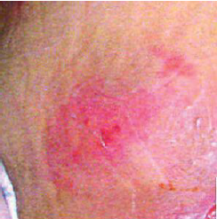
Background
One single HAPI can cost $70,000;
total cost in U.S. is $11 billion dollars annually
California estimated 2017 cost
associated with HAPI is $3.1 billion
In 1999, California became the first state to
establish minimum nurse-to-patient ratios for hospitals.
Beginning in 2008, the Centers for Medicare and Medicaid
Services halted reimbursement for care associated with in-hospital
injury falls and severe HAPI.
Notes:
* National Pressure Ulcer Advisory Panel (NPUAP). CuddiganJ, AyelloEA, SussmanC, Editors. Pressure Ulcers in America: Prevalence, Incidence, and Implication for the Future. Reston, VA: NPUAP; 2001.

Slide 5
Are all nurses the same? Traveling Nurses
Hospitals use traveling nurses to fill short-term staffing shortages.
Traveling nurses are employed by staffing agencies rather than hospitals and go where they are needed.
Assignments generally last 13 weeks, with one week of training
Disadvantage: traveling nurses may lack the knowledge and experience necessary for the specific job. For example, working with a particular computer system or hospital-specific procedures.
Notes:
SO States have mandated number of nurses, BUT there is conflicting research on number of nurses.
Less is known about what type of nurse.
We were interested in whether traveling nurses contribute to worse outcomes.
Patients might be worse because preventing pressure ulcers requires collaboration and consistently following a standard protocol.
Patients might be better because traveling (temporary) nurses may be more contientious and less burned-out.

Slide 6
Objective
To determine the relationship between the number and types of nurse staffing and two nurse-sensitive adverse hospital outcomes: HAPI and falls.

Slide 7
Our data
Hospitals participating in the Collaborative Alliance for Nursing Outcomes (CALNOC) database.
CALNOC is a voluntary consortium of hospitals who supply quarterly data on nurse staffing and outcomes (including HAPI and falls) to a central database.
We included all hospitals with data reported between 2015 and 2016, even if there was never a contract nurse in any of the units.
The final number for our analysis was 605 units in 166 hospitals.

Slide 8
A Conceptual Model
# Beds
Hospital
Teaching or Non-teaching
Nurse Traveler
Nurse Turnover
HAPI
and
Falls
Nurse
Nurse to Patient ratio
Years Experience
Length of Stay
Patient
Age
Medical or Surgical
Other and unknown
Rural Urban
Time
Notes:
Our conceptual model includes variables in the CALNOC database, but also includes variables that were not available to us
Even if the VARIABLES were AVAILABLE, we could not use them because 50% (or more) was missing data (not at random).
We decided not to use some of the variables because of CO-LINEARITY, for example, pt age and medical/surgical are highly related, so we chose medical/surgical

Slide 9
A Conceptual Model
# Beds
Hospital
Teaching or Non-teaching
Nurse Traveler
Nurse Turnover
HAPI
and
Falls
Nurse
Nurse to Patient ratio
Years Experience
Length of Stay
Patient
Age
Medical or Surgical
Other and unknown
Rural Urban
Time
Notes:
We decided to use in FINAL MODEL
ONE HOSPITAL variables: # Beds
TWO NURSE variables: Nurse to patient ratio,
ONE Patient variables: Medical or surgical (highly correlated with Age and LOS)
Other variables were considered for the analysis (e.g. nurse turnover and patient turnover) but not included in the final cluster model because of the amount of non-random missing data. Patient gender and age were not included in the final model because of their high correlation with the proportion of medical patients.
Time could be measured in Quarters, we eventurally decided to analyze a cross-section of the data because many units were involved with continuours quality improvement and we wanted just a snap shot.

Slide 10
Method: Linear Regression
. regress hapi traveler beds ptsperRN medicalpc
 |  |  |  |  |  | Number of obs | = | 596
Source |  | SS | df | MS |  | F(4, 591) | = | 2.16
Model |  | 9.52736387 | 4 | 2.38184097 |  | Prob > F | = | 0.0723
Residual |  | 651.988001 | 591 | 1.10319459 |  | R-squared | = | 0.0144
 |  |  |  |  |  | Adj R-squared | = | 0.0077
Total |  | 661.515365 | 595 | 1.11179053 |  | Root MSE | = | 1.0503
 |  | hapi | Coef. | Std. Err. |  | t | P> |t| | [95% Conf. Interval]
 |  | traveler | 0.0420868 | 0.043362 |  | 0.97 | 0.332 | -0.0430756 | 0.1272493
beds |  |  | 0.0004927 | 0.0002406 |  | 2.05 | 0.041 | 0.0000201 | 0.0009653
 |  | ptsperRN | 0.0375516 | 0.0716971 |  | 0.52 | 0.601 | -0.1032606 | 0.1783637
 |  | medicalpc | 0.0033893 | 0.0016221 |  | 2.09 | 0.037 | 0.0002035 | 0.0065752
 |  | _cons | 0.0271639 | 0.2853744 |  | 0.10 | 0.924 | -0.5333074 | 0.5876352

Slide 11
Problems with linear regression models
There are several potential problems with using a regression model in this analysis:
1. Requires a pre-defined model of the relationships
2. Assumes that hospital, nurse, and patient characteristics are linear.
3. Does not account for complex interaction effects whereby an unit’s scoring high on two or more qualities, could have a larger impact than the sum of the effects taken separately.

Slide 12
Method: Structural equation modeling (SEM)
From the Stata Reference Manual (Release 13):
Structural equation modeling is not just an estimation method for a particular model in the way that Stata’s regress and probit commands are... Structural equation modeling is a way of thinking, a way of writing, and a way of estimating.

Slide 13
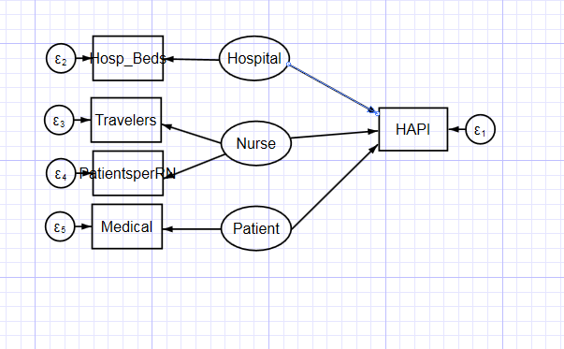
Method: Structural equation modeling
Stata SEM Builder
Notes:
Stata has a SEM builder to make writing syntax easy
Variables in the oval are latent variables.
Variables in the rectangles are observed variables.

Slide 14
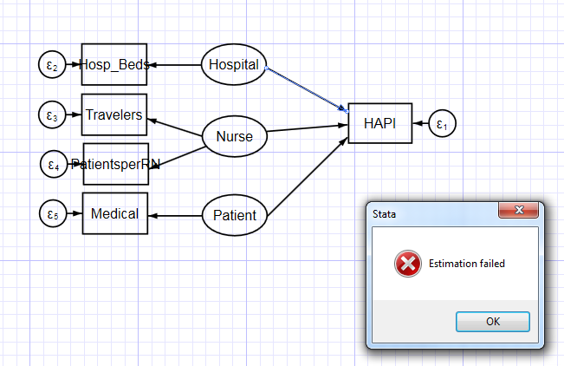
sem (Hospital -> HAPI, ) (Hospital -> Hosp_Beds, ) ///
(Nurse -> HAPI, ) (Nurse -> Travelers, ) (Nurse -> PatientsperRN, ) ///
(Patient -> HAPI, ) (Patient -> Medical, ), covstruct(_lexogenous, diagonal) latent(Hospital Nurse Patient ) /// nocapslatent
Notes:
Estimation failed
SEM does not come up with a model that fits data
Remove Hospital latent variable, still does not run.
Tried “standardized”
Hopes are dashed.
Perhaps SEM failed because a linear relationship is assumed between endogenous and exogenous variables

Slide 15
Method 4: Cluster Analysis
From the Stata Manual:
Cluster analysis attempts to determine the natural groupings
(or clusters) of observations...
[There are] examples of the use of cluster analysis, such as in refining or redefining diagnostic categories in psychiatry, detecting similarities in artifacts by archaeologists to study the spatial distribution of artifact types, discovering hierarchical relationships in taxonomy, and identifying sets of similar cities so that one city from each class can be sampled in a market research task.
Notes:
Method 1: Linear Regression
Method 2: SEM
Method 3: Cluster Analysis – IT”S EXPLORATORY, which is exactly what we are doing
AND data is NOT LINEAR
--- if I look at nurse travelers and hospital size (<200 and >300),
SMALL hospitals with high number of travelers -> low HAPI
LARGE hospitals with high number of travelers -> high HAPI

Slide 16
Cluster Analysis
Variables in the model were first log transformed to approximate a normal distribution because the distribution of these measured variables was skewed.
Variables were then transformed to z-scores using means and standard deviations because scales differed across variables.
We used Wards linkage hierarchical method of cluster analysis with a Euclidean distance option.
Other modeling methods considered for the main analysis were
K-means (not used because of instability with clusters changing with re-sorting the data)
hierarchical average linkage (not used because of the poor distribution of the hospital units among the clusters, with some clusters having only one or two units).

Slide 17
Results
. cluster wards travelerS bedsS ptsperRNS medicalpcS, measure(L2) name(ward)
. cluster gen g5ward = group(5), ties(skip)
. tab g5ward
g5ward | Freq. Percent Cum.
-------------+-----------------------------------
1 | 99 16.61 16.61
2 | 226 37.92 54.53
3 | 99 16.61 71.14
4 | 98 16.44 87.58
5 | 74 12.42 100.00
-------------+-----------------------------------
Total | 596 100.00
Notes:
Stable, does not need sorting
S = Log transformed and Standarized
* How do we know how many clusters?
matrix dissimilarity pwd2 = crnrnpcts TOTAL_STAFFED_BEDSs tot24rns pctmedicals, L2
cluster stop, rule(calinski) /* 5 clusters is the highest */
cluster stop, rule(duda) /* 5 clusters is the highest Je(2)/Je(1) and lowest pseudo T-squared */

Slide 18
Results: Dendogram
. cluster dendrogram HAPI, cutvalue(16) showcount
Notes:
Five groups in Dendrogram, shows hierarchical clustering.
The greater the difference in height, the more dissimilarity

Slide 19
 | Cluster A: Low percent traveling nurses | Cluster B: Low percent medical patients | Cluster C: Small hospital, low number patients per nurse | Cluster D: High patients per nurse | Cluster E: High percent traveling nurses, large hosp | ANOVA sig
Number of units | 74 | 99 | 98 | 226 | 99
HAPI prevalence | 0.32 | 0.41 | 0.51 | 0.57 | 0.84 | 0.012
Hospital
Staffed beds | 342 | 394 | 133 | 293 | 506 | <0.001
Nurse
Pts per nurse | 3.38 | 3.23 | 2.80 | 3.50 | 2.70 | <0.001
Traveling nurses | 0.02 | 5.35 | 6.01 | 5.97 | 7.69 | <0.001
Patient
Medical patients | 73.7 | 26.3 | 78.1 | 79.4 | 86.1 | <0.001
Age | 61.4 | 59.7 | 64.0 | 62.4 | 61.1 | <0.001
HAPI results
Notes:
IF it was increased nurse staffing in general that reduced HAPI, then all clusters with increased nurses/pt should have low HAPI.
Cluster C was small hospitals with high nurse staffing (low numbers of patients per nurse), YET did not have reduced HAPI prevalence.

Slide 20
Confirm Hierarchical Method
clustpop travelerS bedsS ptsperRNS medicalpcS, k(5) type(kmeans) reps(100)
 | Cluster A: Low percent traveling nurses | Cluster B: Low percent medical patients | Cluster C: Small hospital, low number patients per nurse | Cluster D: High patients per nurse | Cluster E: High percent traveling nurses, large hosp
Hierarchical
Number of units | 74 | 99 | 98 | 226 | 99
HAPI prevalence | 0.32 | 0.41 | 0.51 | 0.57 | 0.84
Traveling nurses | 0.02 | 5.35 | 6.01 | 5.97 | 7.69
K-means
Number of units | 75 | 47 | 101 | 202 | 154
HAPI prevalence | 0.39 | 0.43 | 0.37 | 0.60 | 0.73
Traveling nurses | 0.01 | 4.44 | 6.98 | 5.49 | 7.05
Notes:
Hierarchical analysis is essentially a sample of N=1 from the population of possible clustering groupings
Clustpop runs CLUSTER many times to estimate the population group assignments
The most frequent group assignment is take as the estimate of the population.
Kmeans with 100 reps shows same pattern

Slide 21
Confirm Hierarchical Method
 | Cluster A: Low percent traveling nurses | Cluster B: Low percent medical patients | Cluster C: Small hospital, low number pts per RN | Cluster D: High patients per nurse | Cluster E: High percent traveling nurses, large hosp | ANOVA
Number of units | 69 | 74 | 136 | 241 | 81
HAPI 3+ incidence | 0.017 | 0.040 | 0.018 | 0.035 | 0.055 | 0.001
Hospital
Staffed beds | 355 | 442 | 158 | 299 | 556 | <0.001
Nurse
Pts per nurse | 3.37 | 3.23 | 2.77 | 3.56 | 2.84 | <0.001
Traveling nurses | 0.003 | 4.21 | 7.14 | 5.63 | 7.22 | <0.001
Patient
Medical patients | 73.4 | 19.5 | 78.5 | 75.4 | 86.0 | <0.001
Age | 61.3 | 58.9 | 63.9 | 62.2 | 60.6 | <0.001
HAPI 3+
results
Notes:
TEST MODEL for different severity, INCIDENCE patients with injuries/1000 patient days.
Cluster E, with the highest percent of nurse travelers (>7%) also had the highest HAPI 3+ incidence (0.055 per 1000 patient days), despite high nurse staffing.

Slide 22
 | Cluster A: Low percent traveling nurses | Cluster B: Low percent medical patients | Cluster C: Small hospital, low number patients per nurse | Cluster D: High patients per nurse | Cluster E: High percent traveling nurses, large hosp | ANOVA
Number of units | 128 | 56 | 120 | 210 | 89
Falls | 2.54 | 1.80 | 2.68 | 2.39 | 2.73 | 0.0017
Hospital
Staffed beds | 377 | 416 | 145 | 290 | 519 | <0.001
Nurse
Pts per nurse | 3.47 | 3.07 | 2.75 | 3.57 | 2.86 | <0.001
Traveling nurses | 0.15 | 7.01 | 7.30 | 6.25 | 6.10 | <0.001
Patient
Medical patients | 66.5 | 19.3 | 75.7 | 76.5 | 88.2 | <0.001
Age | 60.6 | 58.6 | 64.1 | 62.5 | 61.5 | <0.001
Falls results
Notes:
No consistent relationship was identified between contract nurse rates and falls.
Fall rates did not differ greatly between clusters, with the exception of Cluster B, which had lower proportion of medical patients, and significantly lower fall rate (1.80 falls/1000 patient days)
This is expected because Cluster B would be mostly surgical patients, for example hip and knee replacement, which have less delirium and dizziness and falls due to anesthesia and are younger and healthier than medical patients.
No relationship between Traveler Nurses and Falls is consistent with other findings in the literature. Perhaps, fall prevention may be less reliant on nursing skill and teamwork, and more dependent on unlicensed care providers and hospital protocols.

Slide 23
Implications
The highest rates of HAPI were observed in units with higher proportion of traveling nurses and high proportion of medical patients, in larger hospitals.
While higher nurse staffing was not associated with fewer HAPI.
There was no relationship between falls and traveling nurses.
Our results suggest that hospitals should either minimize use of traveling nurses, or engage in extensive nurse training to insure that traveling nurses are familiar with hospital practices around HAPI.

Slide 24
Cluster Analysis
Cluster analysis is not based on assumptions of consistent interactions or relationships between variables, and does not require the outcomes to fit a specific linear or other form.
Cluster analysis is exploratory analysis, which is appropriate for this data
Cluster analysis revealed meaningful patterns of hospital and nurse characteristics, and associated outcomes

Slide 25
Discussion
Any recommendations to strengthen this analysis?
What are the limitations in using this method?
What other statistical methods could be used with this data?

